Slide 1
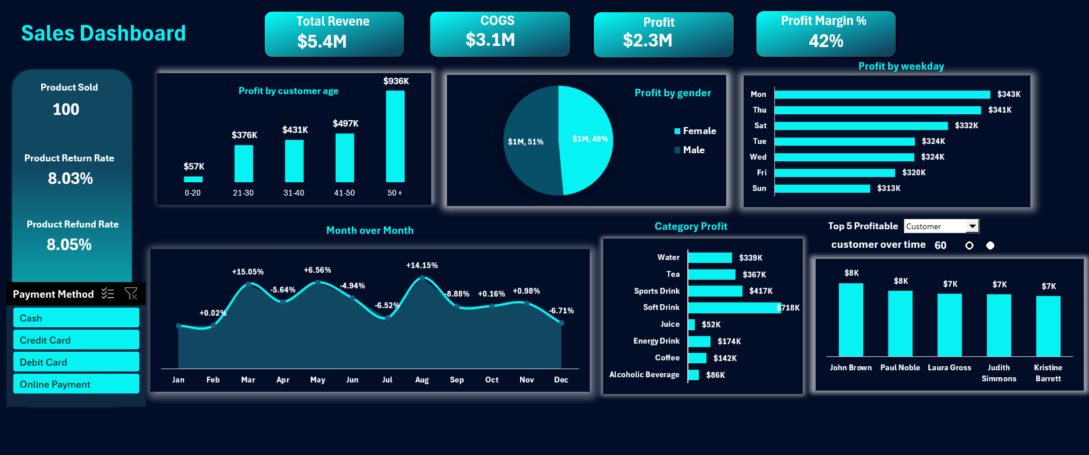

Slide 2
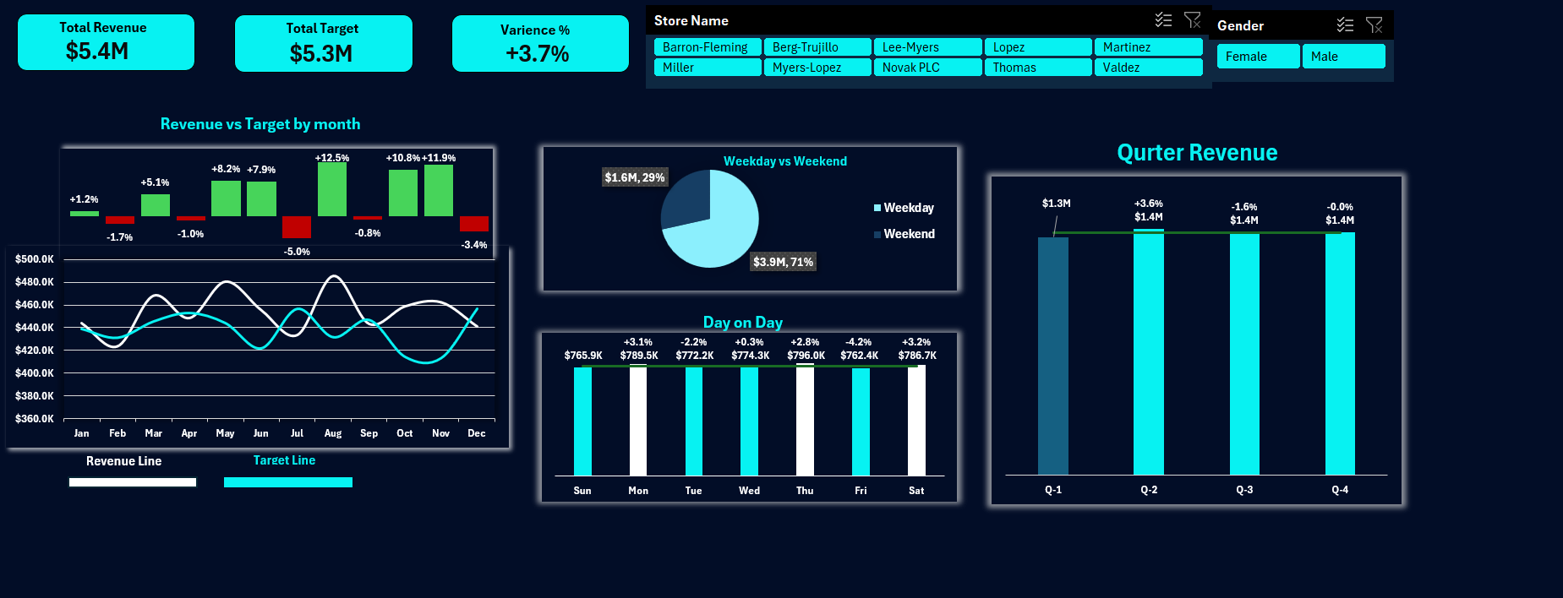

Slide 3
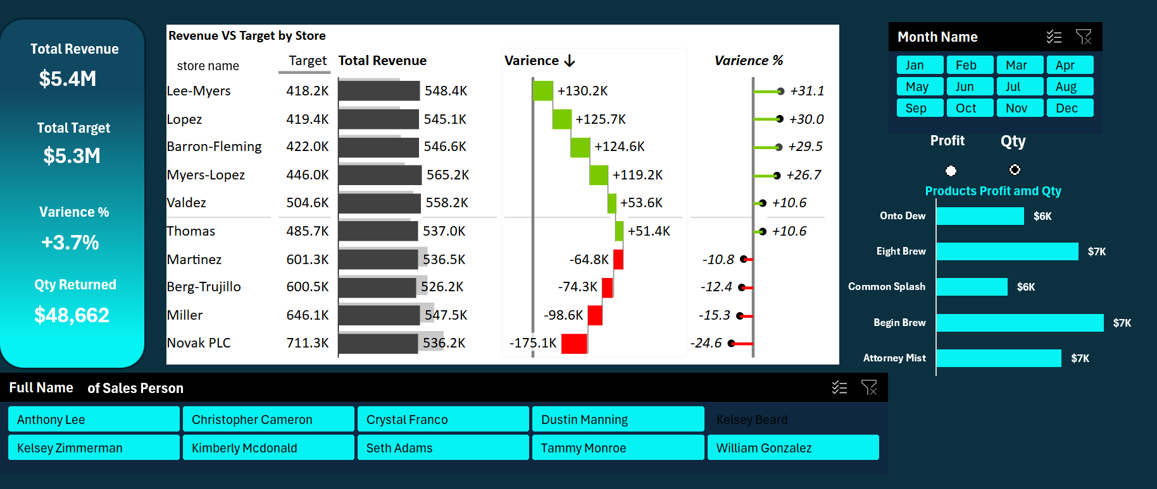

Slide 4
Which months had the highest and lowest sales?
August ana may have the Highest revenue
February and July have the lowest revenue

Slide 5
Is any store consistently underperforming vs. its target?
Yes , Martinez by -10.8%
Berg-trujillo by -12.4%
Miller by -15.3%
Novak Pls by -24.6% which is the worst store

Slide 6
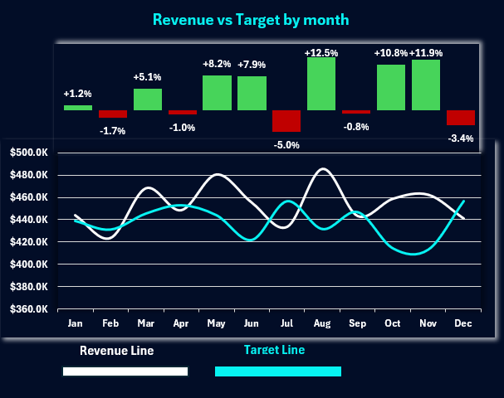
Compare the actual monthly sales against the Monthly Target for each store.

Slide 7
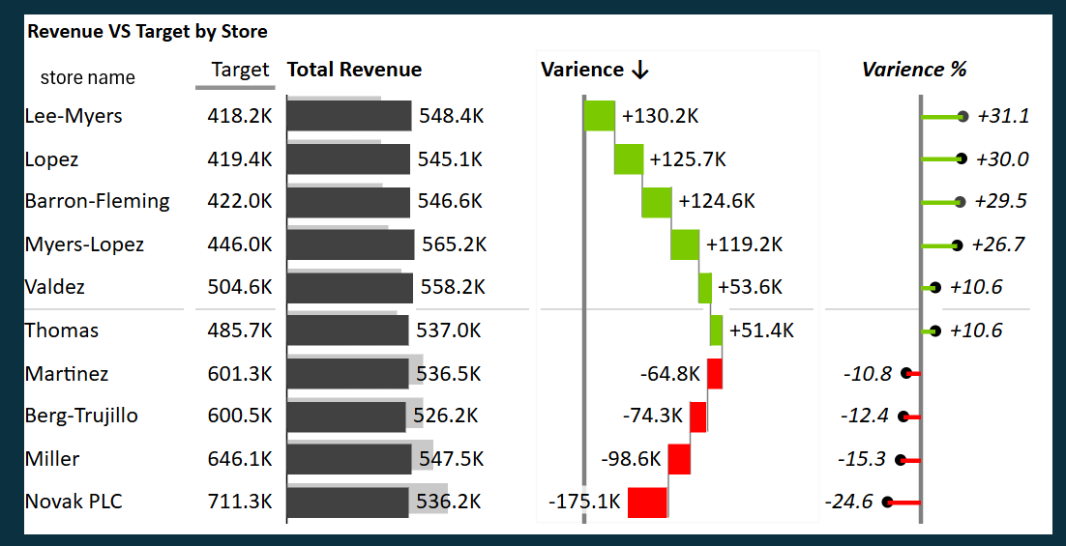
Calculate the percentage of target achieved for each store

Slide 8
Total Sales and Returns:
o What is the total revenue generated
o What is the total cost of goods sold
o What is the total profit
o What is the total number of items sold?
o What is the total number of items returned?
o What is the overall return rate?
Sales Trends Over Time:
o How have total sales (revenue and quantity) trended month-over-month
throughout the year?
o Which months had the highest and lowest sales?
Top Products and Categories:
o What are the top 5 best-selling products by quantity sold?
o What are the top 5 products generating the most revenue?
o What are the top 5 product categories by revenue and quantity sold?
o What is the average Sales Price and Cost Price per product category?
Product Profitability:
o Which products or categories have the highest profit margins
o Identify the top 5 most profitable products.

Slide 9
Top Customers:
o Who are our top 5 customers based on the total revenue they generated?
o How many unique customers do we have?
Customer Demographics:
o What is the distribution of sales by customer Gender?
o Which Location (state) generates the most sales?
o What is the distribution of our customer base by Location?
Store Performance vs. Targets:
o What are the total actual sales (revenue) for each store for each month?
o Compare the actual monthly sales against the Monthly Target for each store.
Which stores met or exceeded their targets? Which fell short?
o Calculate the percentage of target achieved for each storeo Identify the top 3 and bottom 3 performing stores based on target
achievement.
o What is the total revenue generated by each Payment Method?
- How do sales and returns vary by month?
- Is any store consistently underperforming vs. its target?

